Slide 1
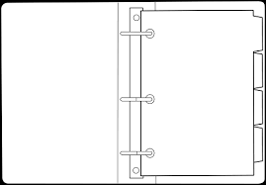
DRONE FUNDAMENTALS CURRICULUM
Tied Caldwell
Plainfield Parks & Recreation Dept.
Girls and Boys ages 8-16
Communication
tcaldwell@dronels.org
Call or Text 908-209-2794
Hands on training?
Communication
Participation & Preparation
You are expected to participate and be prepared for class every week with the items listed below.
Knowledge & Quizzes
You will be given a quiz at the end of some modules. Periodically, you’ll be asked to provide details about drones from previous modules.
Content/ Modules
What is a Drone?
Drone Capabilities
Safety Regulations
Drone Opportunities
Have Fun
This course is designed to introduce you to different functions of drones and collaborate with your peers to get the most out of your drone experience. Therefore, let’s have fun and support each other while doing it.
Computer that can connect to Wi-Fi.
Personal drone (optional)
Cellphone (optional)
Notepad/paper
Pen or pencil if you want to take notes.
Email address (optional)
Class
Materials
Materials are optional for each class or we can share with our peers.

